Slide 1





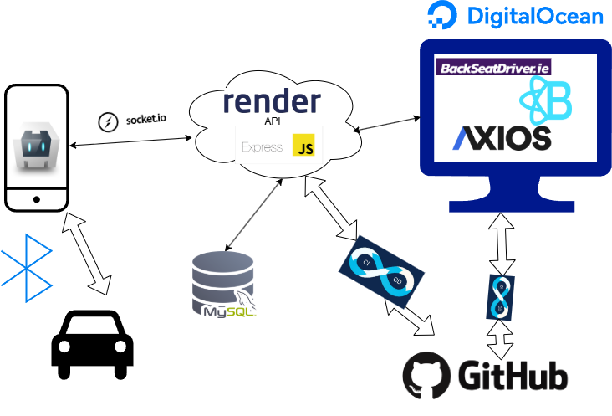

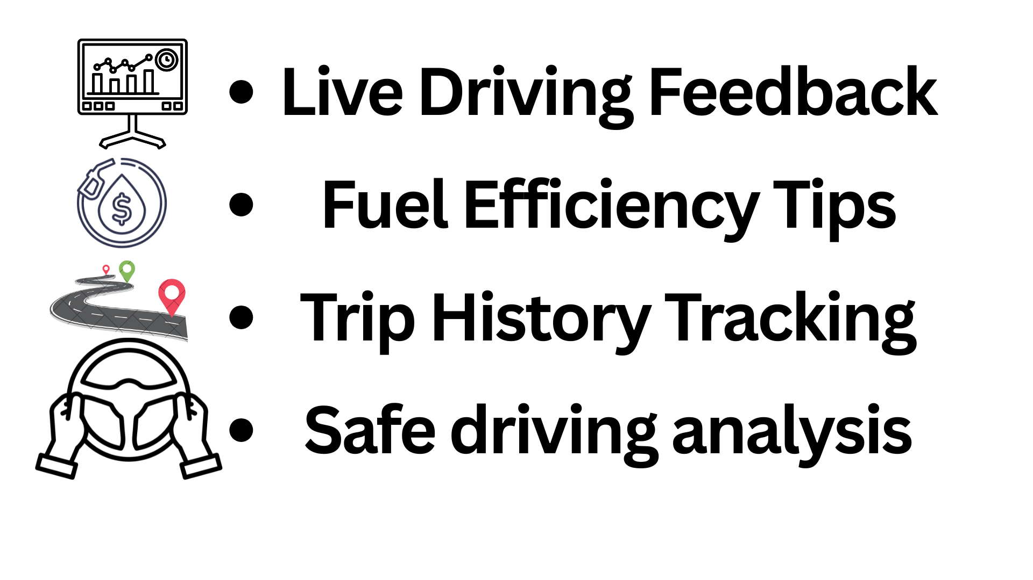
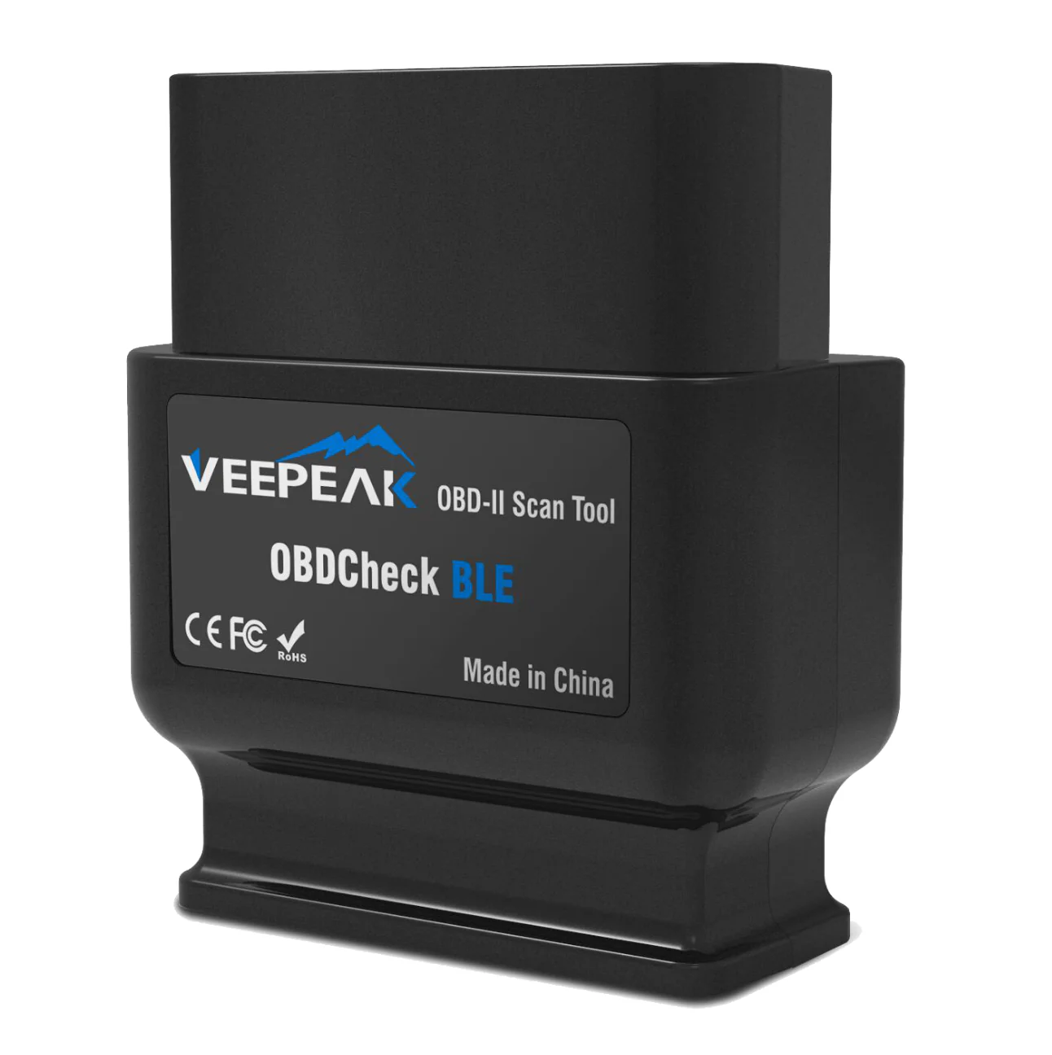
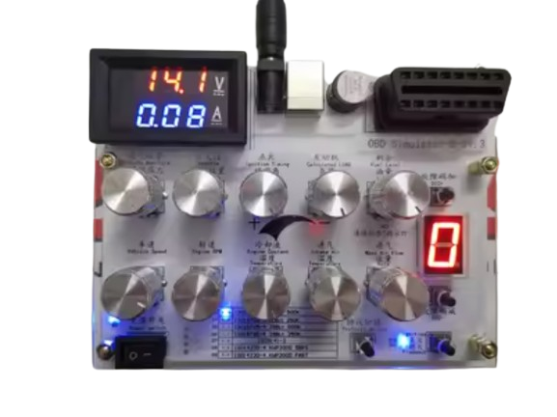
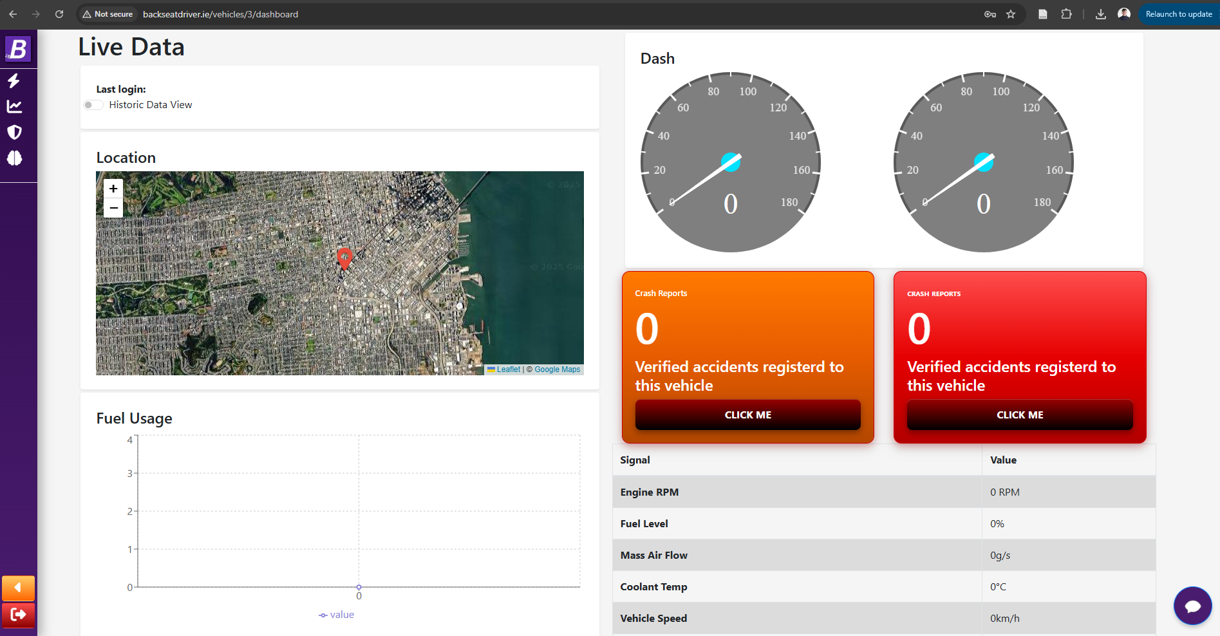
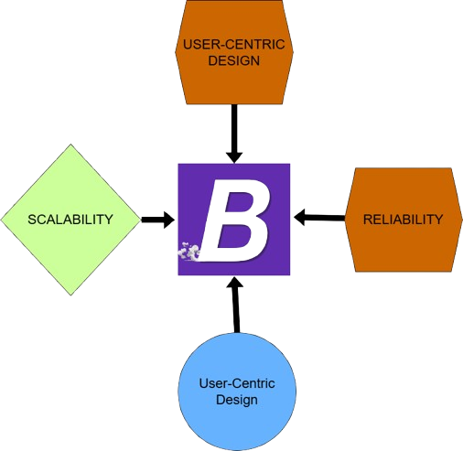
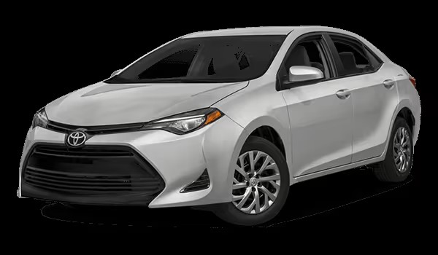
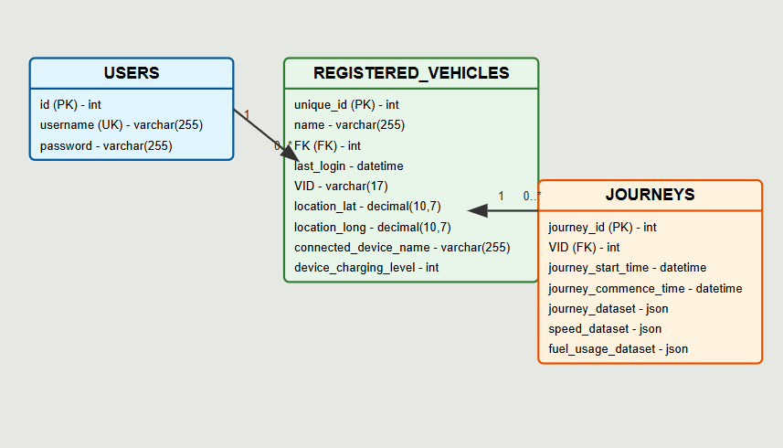





Caolán Maguire
G00385433
Introduction
Overall System Architecture
Scalable Cloud Architecture
BackSeatDriver.ie – A Final Year Project BackSeatDriver.ie is a final year project developed to help drivers make their journeys safer, smarter, and more efficient. The system connects a mobile phone to a Bluetooth OBD-II dongle plugged into a vehicle. As you drive, data is gathered securely and stored on the cloud, allowing drivers to review their trips, performance, and vehicle health at any time through a dedicated website.
How It Works Once connected, the application collects live data from the car’s onboard systems, such as speed, engine performance, and fuel usage. This information is processed in real-time, highlighting areas for improvement and recommending more eco-friendly driving techniques. All journey data is saved for later analysis, giving drivers clear insights into their habits and vehicle condition.
Key Features BackSeatDriver.ie offers live data of their journey, eco-driving recommendations, trip history tracking, and driver performance scoring. These features combine to help drivers reduce fuel costs, prevent costly repairs, and drive more safely and responsibly.
Project Goals and Outcomes The aim of this project is to showcase how affordable, real-time vehicle telematics can be made accessible to everyday drivers. By leveraging cloud technology, Bluetooth connectivity, and web integration, BackSeatDriver.ie demonstrates the potential of smart driving apps to improve road safety, reduce environmental impact, and lower the overall cost of vehicle ownership.
Built for Drivers, Powered by Data Whether you're a daily commuter, a learner driver, or someone simply looking to drive smarter, BackSeatDriver.ie empowers users with practical insights and actionable advice. Every journey becomes an opportunity to drive better, saving fuel, protecting the vehicle, and contributing to safer roads for everyone.
DEPLOYMENT
The deployment service used in this project allows scalability at a large level, if required resources can be procured easily for customer need – meaning this service could in theory serve a large number of customers at one time
Features and Functionality
Hardware
Testing
Dashboard
VEEPAK OBD-II Bluetooth scanner
Design Philosophy
For the development and testing of this application, we utilized an OBD-II simulator to mimic the behavior of a real vehicle's onboard diagnostic system. This allowed us to thoroughly test the app's functionality, including data retrieval and analysis, without requiring access to an actual vehicle. By simulating a variety of driving conditions and error scenarios, we were able to ensure that the app accurately processes OBD-II data and provides users with reliable insights into their driving performance.
The simulator also provided a controlled environment to fine-tune features such as vehicle health monitoring, fault detection, and efficiency recommendations. This iterative testing process ensured the app’s robustness, allowing for a seamless user experience before moving to real-world implementation with physical vehicles. The software was then tested on a real vehicle, ensuring its functionality and accuracy in real driving conditions.
DASHBOARD
The dashboard is accessible while the vehicle is in use or after it's active. It displays a speedometer and RPM gauge, a crash report counter, signal output, fuel level tracking, and a live map with a polyline that follows the vehicle’s journey. Additionally, a pie chart provides a visual breakdown of the speed brackets the car is traveling within.
--Usage & Efficiency Page
This page presents a calendar showing usage , total journeys, total distance travelled, average journey duration, breakdown of each journey, breakdown of overall speed brackets the vehicle travels within and days active. AI Gen AI produces actionables based on journeys
-Safety
Shows a marked score for driver safety, a map with plotted locations of accidents, and a count of hard braking, speeding and hard acceleration incidents.
Chatbot
A
B
Conclusion and Future Directions
BackSeatDriver successfully leverages telematics and data analysis to provide users with real-time feedback on their driving habits, aiming to promote more efficient and responsible driving. Through the use of CAN data analysis, the application offers valuable insights into driving performance, identifies areas for improvement, and predicts potential vehicle issues. The project highlights the potential of using connected car technologies to enhance driver safety and reduce fuel consumption. Looking ahead, there is significant potential to expand BackSeatDriver with additional features, such as integration with more vehicle models, enhanced predictive maintenance, and advanced machine learning algorithms to provide personalized recommendations. Further development could also include integration with smart devices, improving user engagement and data accuracy.
Tested on a Toyota Corolla 2017
Database Structure
Main Technologies
Frontend
Backend
Database

